Slide 1
Executive summary
Exploratory Data Analysis of New York City TLC Data

Slide 2
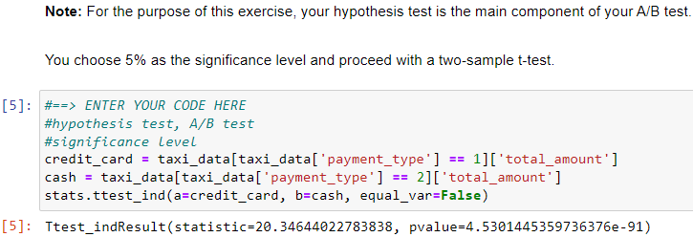
Executive summary report
Commission Prepared by Automatidata
The purpose of this project is to predict taxi cab fares before each ride. At this point, this project’s focus is to find ways to generate more revenue for New York City taxi cab drivers. This part of the project examines the relationship between total fare amount and payment type.
Taxi cab drivers receive varying amount of tips. While examining the relationship between total fare amount and payment type, this project seeks to discover if customers who pay in credit card tend to pay a larger total fare amount than customers who pay in cash.
The Automatidata team ran an A/B test to analyze the relationship between credit card payment and total fare amount. The key business insight is that encouraging customers to pay with credit cards will likely generate more revenue for taxi drivers.
Steps conducted in the A/B test
Collected sample data from an experiment in which customers are randomly selected and divided into two groups:
Customers who are required to pay with credit card.
Customers who are required to pay with cash. This enables us to draw causal conclusions about how payment method affects fare amount.
Image Alt-Text Here
2. Computed descriptive statistics to better understand the average total fare amount for each payment method available to the customer.
3. Conducted a two-sample t-test to determine if there is a statistically significant difference in average total fare between customers who use credit cards and customers who use cash.
The Automatidata data team recommends that the New York City TLC encourages customers to pay with credit cards, and create strategies to promote credit card payments. For example, the New York City TLC can install signs that read “Credit card payments are preferred” in their cabs, and implement a protocol that requires cab drivers to verbally inform customers that credit card payments are preferred. Even better, a 1% cashback can be implemented to motivate them to keep paying with credit card for future ride purchases.

